Slide 1

Databricks Asset Bundles Implementation Plan

Slide 2
Introduction
Phase 1 (POC)
  Implementation of the Asset Bundles at Environment Level
Phase 2
  Implementation of the Asset Bundles at Sub Environment Level

Slide 3
Solution design – Asset Bundles
Environments |  | Notebooks |  | Workflows | Pipelines | Asset Bundles
 |  | Shared + DLTs notebooks | All other Notebooks
Development | dev | ✓ |  | ✓ | ✓ | ABundleEnvironment
 | dev_001 |  | ✓ | ✓ | ✓ | ABundleSubEnvironment
 | dev_002 |  | ✓ | ✓ | ✓ | ABundleSubEnvironment
 | dev_003 |  | ✓ | ✓ | ✓ | ABundleSubEnvironment
 | dev_004 |  | ✓ | ✓ | ✓ | ABundleSubEnvironment
Test | test | ✓ |  | ✓ | ✓ | ABundleEnvironment
 | test_001 |  | ✓ | ✓ | ✓ | ABundleSubEnvironment
 | test_002 |  | ✓ | ✓ | ✓ | ABundleSubEnvironment
Prod | prod | ✓ | ✓ | ✓ | ✓ | ABundleEnvironment and ABundleSubEnvironment
✓ - Don’t exist currently but the asset bundles will be prepared if they exist

Slide 4
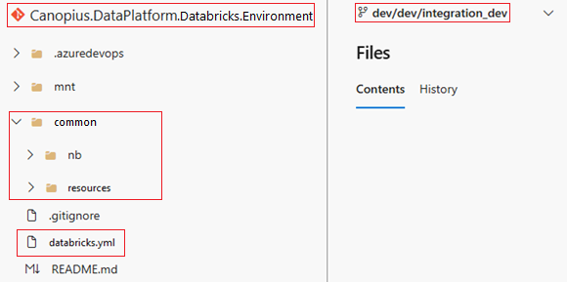
Phase 1 – Environment Level - DEV
Do an inventory of all the resources to include in the Environment Level Asset Bundle (notebooks, jobs, pipelines (DLTs), dashboards) [Canopius.DataPlatform.Databricks.Environment]
Create a repository for the environment level and add the necessary folders and notebooks (nb folder)
Create a branch dev/dev/integration_dev

Slide 5
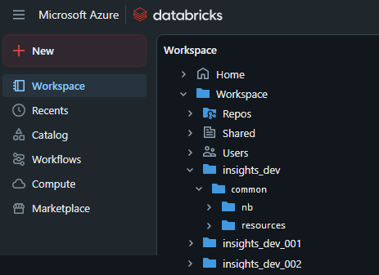
Phase 1 – Environment Level - DEV
Create an environment workspace folder in databricks (insights_dev) with a sub-folder “common”. Create a sub-folder “resources” at the same level as the “nb” folder (this will contain the .yml files for the resources)

Slide 6
Phase 1 – Environment Level - DEV
Create a databricks.yml file inside “insights_dev/common” (this will be the file used by the asset bundle)
Create a configuration yml file for each of the resources inside the “insights_dev/common/resources” folder (check what need to be dynamic)
Configure the databricks.yml file (include the resources, set the targets)
Test the asset bundle manually using Databricks CLI
Check if all the resources and notebooks are deployed correctly

Slide 7
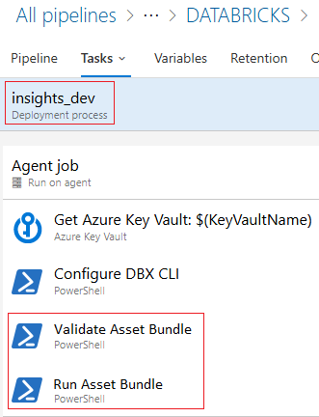
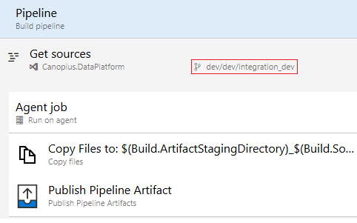
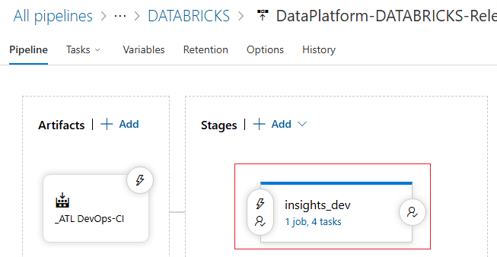
Phase 1 – Environment Level - DEV
Create a devops pipeline pointing to the repository created previously to produce an artifact with the environment asset bundle. Enable continuous integration (integration_dev branch).
Create a devops release that uses the artifact created previously. This release publish the artifact, validates the asset bundle and if succeeded runs it. Release to be run on demand.
Test the devops pipeline and release.

Slide 8
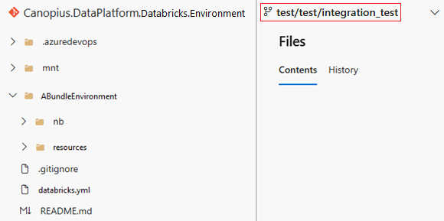
Phase 1 – Environment Level – TEST and PROD
Create a test branch for the environment level on the previously created repo
Test the asset bundle manually using Databricks CLI, using TEST as target.
Check if all the resources and notebooks are deployed correctly.

Slide 9
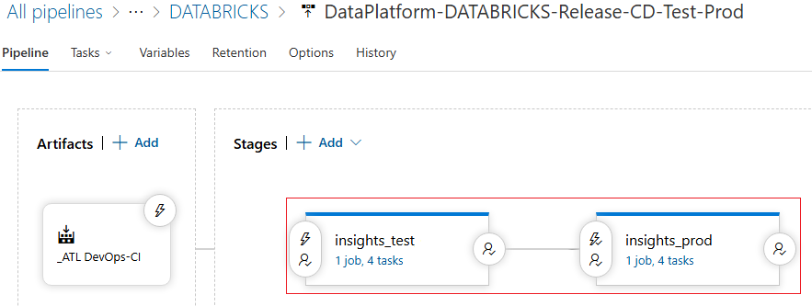
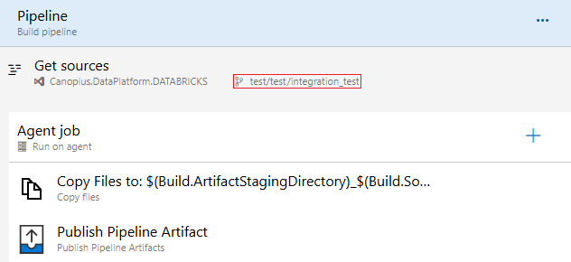
Phase 1 – Environment Level – TEST and PROD
Create a devops pipeline pointing to the repository created previously to produce an artifact with the environment asset bundle. Enable continuous integration (integration_test branch by pull request).
Create a devops release that uses the artifact created previously. This release publish the artifact, validates the asset bundle and if succeeded runs it. Deploys to TEST and PROD after validation. Release to be run on demand.
Test the devops pipeline and release.

Slide 10
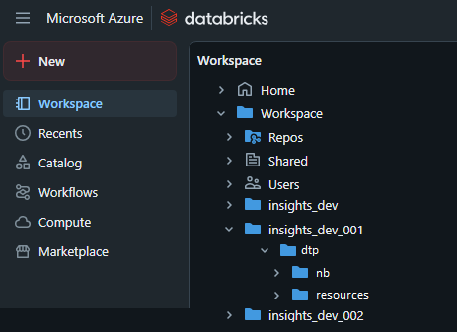
Phase 2 – Sub Environment Level dev_00X
Do an inventory of all the resources to include in the Sub Environment Level Asset Bundle (notebooks, jobs, pipelines (DLTs), clusters, dashboards, unit catalog (registered model, schema and/or volume objects))
On the sub environment workspace folders in databricks (insights_dev_001, insights_dev_002, insights_dev_003, insights_dev_004), create a sub-folder “resources” at the same level as the “nb” folder (inside the dtp folder). This will contain the .yml files for the resources. [not using the sub environment bundle name to keep the folders names]

Slide 11
Phase 2 – Sub Environment Level dev_00X
Create a databricks.yml file inside “insights_dev/dtp” (this will be the file used by the asset bundle)
Configure the databricks.yml file (include the resources, set the targets)
Test the asset bundle manually using Databricks CLI
Test the deployment of the sub_environment bundle to the environment level (this is to reproduce what will happen in prod, it is not supposed to happen at the dev level but needs to be tested)
Check if all the resources and notebooks are deployed correctly

Slide 12
Phase 2 – Sub Environment Level dev_00X
Keep the existing devops pipeline (it is already copying the integration branch contents). It will produce an artifact with the asset bundle. Check if there are any necessary changes.
Alter the existing devops release to use the artifact created previously. This release needs to publish the artifact, validate the asset bundle and if succeeded run it. Release to be run on demand.
Test the devops pipeline and release in the 4 dev sub environments.

Slide 13
Phase 2 – Sub Environment Level test_00X and prod
Test the asset bundle manually using Databricks CLI, using test_00X as target.
Check if all the resources and notebooks are deployed correctly.
Keep the existing devops pipeline (it is already copying the integration branch contents). It will produce an artifact with the asset bundle. Check if there are any necessary changes.
Alter the existing devops release to use the artifact created previously. This release needs to publish the artifact, validate the asset bundle and if succeeded run it. Deploys to tes_00X and prod after validation. Release to be run on demand.
Test the devops pipeline and release.

Slide 14
Summary
The folder structure for the repositories and databricks workspaces:
Repository | Dev Branch | Dev Workspace Folders | Test Branch | Test Workspace Folders
Canopius.DataPlatform.DATABRICKS.Environment | dev/dev/integration_dev | insights_dev/common/nb insights_dev/common/resources | test/test/integration_test | insights_test/common/nb insights_test/common/resources
Canopius.DataPlatform.DATABRICKS | dev/dev1/integration_dev_001 dev/dev2/integration_dev_002 dev/dev3/integration_dev_003 dev/dev4/integration_dev_004 | insights_dev_00X/dtp/nb insights_dev_00X/dtp/resources | test/test1/integration_test_001 test/test2/integration_test_002 | insights_test_00X/dtp/nb insights_test_00X/dtp/resources

Slide 15
Handover
Produce the necessary documentation for handover (design documentation + wiki “how to” + training ppt)
Do training sessions for the asset bundles handover

